Slide 1
Topic 4:
Implementing Reliable and Efficient Communication

Slide 2
Acknowledgements
Slides derived from slides of Petterson Davie book, slides on Computer Networks by Prof. Nick McKeown from Stanford and Dr. Anirudh Sivaraman from New York University.

Slide 3
Reliability Problem
* Given an ordered list of packets P1, P2, . . . , PN at a sender, the problem is to reliably transmit them to the receiver in the same order
→ packets may be dropped
→ packets may get duplicated
→ packets may get delayed
Additional assumptions:
→ network is not partitioned
→ sender and the receiver do not crash

Slide 4
Two Fundamental Concepts for implementing Reliability
Acknowledgements
Timeouts

Slide 5
Automatic Repeat Request
Sender transmits a packet and begins the retransmission timer
Sender waits for acknowledgement
If the acknowledgement is not received within the timeout, then the sender retransmits the packet
How many outstanding packet (or unacknowledged frames) are allowed?
What is an appropriate timeout value? Too small/ too big → ??

Slide 6
Stop-and-wait protocol (Sender)
** Send a packet
** Wait for an ACK by setting a retransmission timer
** When retransmission timer times out, retransmit packet, wait for ACK again
** Once packet is received and ACKed, move on to the next one.

Slide 7
Stop-and-wait protocol (Receiver)
** ACK every packet
** Maintain next_in_order variable corresponding to the next packet that is expected to maintain reliable in-order abstraction
** If packet number equal next_in_order, increment it. Otherwise do nothing and discard the packet.

Slide 8
Packet identification
* Need to identify packet by a number in both data and ACKs
** Commonly called a sequence number
** TCP sequences bytes
** TCP segments carry both a sequence number and an ACK number (they are bidirectional)

Slide 9
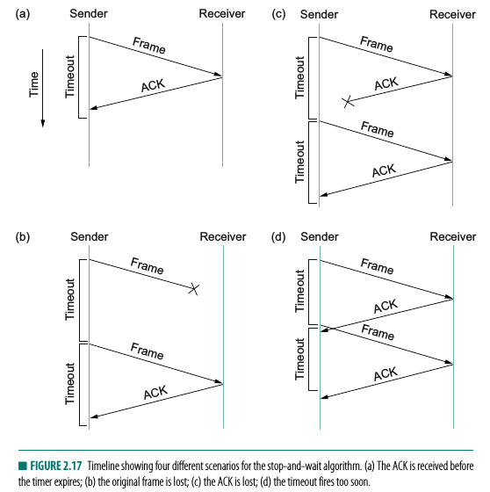
Stop-and-Wait

Slide 10
Throughput of Stop-And-Wait
** Roughly once every RTT: round-trip time between sender and receiver
** RTT is an important concept in networking.
** 1/RTT is quite bad.
e.g. Large (high RTT) and Fat (high bw) Network
RTT: 100 ms, 100 Mbit/s link, 1460 byte frame
It's 0.01 % of the link capacity

Slide 11
Retransmission Timers
* What should be the value of the retransmission timer?
** Too small → network flooded with duplicate packets, wastes network capacity
** Too large → underutilized network
* lower bound on retransmission timer? RTT.
* But the RTT isn't precisely known. It's a random variable.
* Want to pick a threshold so that P(RTT > Th) is small.
* One possibility: mean + a few standard deviations

Slide 12
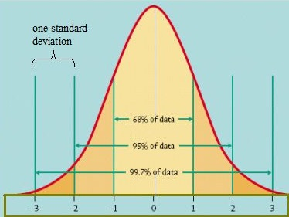
* Tail probability falls off quickly with number of standard deviations e.g. Normal distribution
* timeout = μ + 4.σ in TCP (very conservative)

Slide 13
Estimating mean RTT (μ)
* Collect many RTT samples and estimate the mean offline
* But network conditions change (queueing delay, path changes, node is mobile, etc.)
* Need to estimate RTT online => must be fast

Slide 14
Exponentially Weighted Moving Average
** μ ← μ*(1 - α) + α* RTT
* Why does this make sense?
** First, it's fast.
** Second, it gives more weight to new samples than old ones.
*** Older samples are exponentially decayed
** Third, it is an average in a real sense, e.g. RTT remains constant
*** If RTT settles to a new value, μ gets there quickly
** What should be the value of α? Big / Small ??
*** TCP uses 0.125

Slide 15
How to measure RTT?
* Sender includes a time-stamp value in the header of the packet.
* The receiver echoes the sender’s time-stamp in the acknowledgement.
* Sender then subtracts the acknowledgement time-stamp from the current wall clock time to compute the RTT.

Slide 16
Estimating sigma
** Use absolute deviation instead of standard deviation
*** It's easier to compute

Slide 17
Exponential backoff
*What if retransmitted packet is lost?
** Might indicate that we have *no* idea what the RTT is
*** we set it too small
*** Or some sudden change in the network usage (flash crowd)
** Double timeout until something is ACKed and you can start computing RTTs again

Slide 18
Sliding Window Protocol
* Stop and Wait: too inefficient
* Throughput is only 1 every RTT, which can lead to very bad network utilization in large and fat networks
* Sliding window protocol:
** Send out a set of W packets while waiting for ACK. Thus network is not idle.
** When ACK is received transmit another packet
** Packet conservation principle: number of outstanding packets without ACKs is kept constant
* Why is it called sliding window?
* This window is continuously sliding. It starts at 1, 2, ... W, Then moves to 2, 3, 4, ...W+1 and so on.

Slide 19
Sliding Window Sender
* Keep track of the number of unacked packets.
** Ensure that it is never greater than W.
** Every time an ACK is received, send out a new packet.
* Window can get fragmented on packet loss: multiple fragments of packets with continuous sequence numbers
* When packets are lost:
* Retransmit as before.
* Same retransmission timer as Stop-And-Wait

Slide 20
Sliding Window Receiver
* ACK every packet
* Maintain a list of packets received out of order.
* Maintain a variable for next packet expected in order.
* Update this variable if a newly received packet fills a hole in the packet sequence. Deliver in-order packets to the application.
* In Sliding Window next_in_order can jump over many packets. In Stop And Wait, it only ever advances by 1. This is the source of higher throughput

Slide 21
Sliding Window Throughput
* Assume that loss rates are negligible; Internet loss rates are on the order of 1%, so this is reasonable.
* Simple model for computing throughput
* Sender ---> Link (Capacity C packets/second) ---> Receiver
* Minimum round-trip time (excluding queueing and transmission delays) of RTT
* Sometimes called RTT_{min}. We'll use RTT for simplicity.

Slide 22
Sliding Window Throughput contd.
* An Internet path can have many hops between the sender and the receiver
* Replace C with the speed of the slowest link on the path (also called bottleneck)
* W packets are sent out at time 0.
* The last bits of each of these packets leaves the sender at times 1/C, 2/C, ... W/C
* Receiver receives them RTT/2 later: RTT/2 + 1/C, RTT/2 + 2/C, ...
* ACK comes back RTT/2 later: RTT + 1/C, RTT + 2/C , ... (assuming transmission delay of ACKs can be ignored).

Slide 23
Sliding Window Throughput contd.
* After RTT + W/C, W packets have been acked
* After RTT + W/C + 1/C, the 2W^{th} packet has been sent out
* It is received RTT/2 later, and acked another RTT/2 later.
* 2W^{th} packets are acked at the end of RTT + W/C + 1/C + RTT
* 3W packets are acked at the end of RTT + W/C + 1/C + RTT + 1/C + RTT
* kW packets at the end of k*RTT + W/C + (k-1)/C
* Throughput is kW/(k*RTT + W/C + (k-1)/C), which is W/RTT
* For large k
* assuming 1 << C*RTT, which was the argument for sliding windows in the first place

Slide 24
Sliding Window Throughput contd.
* Throughput goes up with W. Can we just keep increasing the throughput this way?
* As C is the max capacity of the channel, we can transmit at max RTT*C packets before the first acknowledgement is received
* If W exceeds C*RTT, the packets start queuing up at the sender’s end. Throughput does not increase.
* what is the extent of the queueing delay?
#packets_in_front_in_the_queue/C
* Is queueing delay useful?
** No. Can destroy interactivity for SSH (btw SSH runs on TCP)

Slide 25
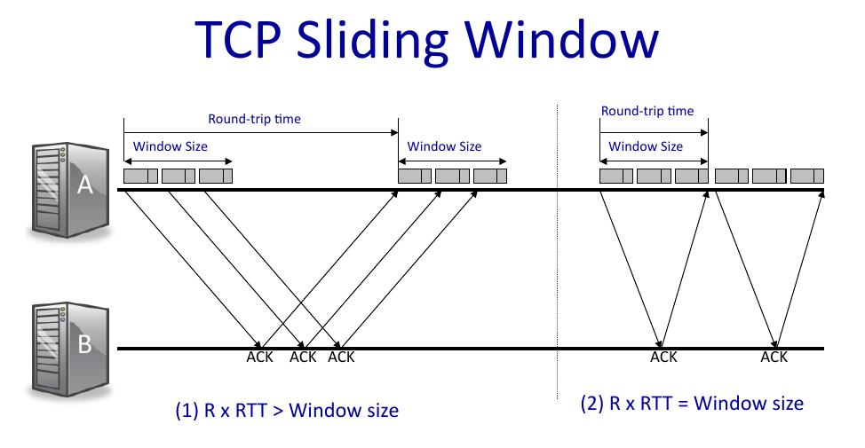

Slide 26
Correct value of W
* So we should set W to C*RTT; but setting it exactly is impractical
* We don't know C and RTT
* They can vary over the life-time of the flow
** in wireless link, C depends on how far you are from the wifi-router.
** RTT is different for different medium; depends on the route between sender to receiver (assume some router goes down)
* Setting W to values much more than C*RTT gives rise to queueing delays.
* As queue builds up, the retransmission timer goes off and a duplicate packet is inserted in the network

Slide 27
What happens if everyone sets their own large window?
* Delays go up for everyone. Interactive apps are frustrated
* Duplicate packets degrade throughput
* Further compounded when there are multiple senders, setting their W independently
* Don't know effective C (depends on other flows)
* Effective window is sum of individual windows

Slide 28
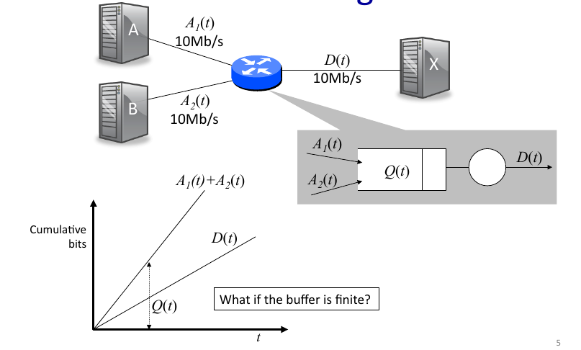
Example of shared link (effective size)
We need some notion of fairness to decide how a bottleneck link
will be shared by multiple flows.

Slide 29
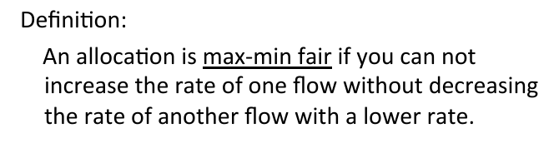
Max-min Fairness
Fair queuing is implemented at the routers, but there is no mechanism to signal the source that they should slow down.

Slide 30
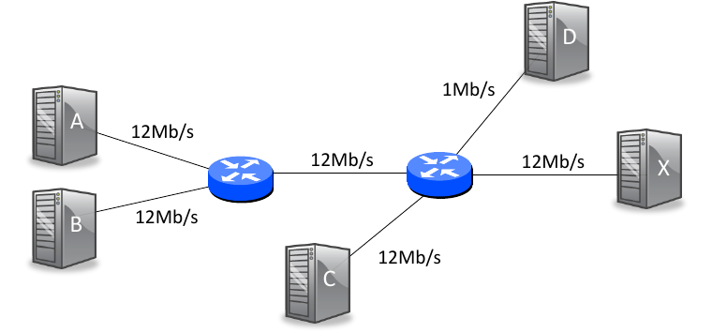
Another Example

Slide 31
What happens if everyone sets their own large window?
* Delays go up for everyone. Duplicate packets degrade throughput
* Further compounded when there are multiple senders, setting their W independently
* The term used is: congestion collapse
* Formally, after a nw has collapsed, offered load (demand) for the nw is going up, but utility (useful work) is going down.
* In OS: when the process’s working set doesn’t fit in the memory, then it thrashes

Slide 32
Congestion Collapse Example
* Suppose there are n simultaneous flows with sliding window size w on a shared link with capacity C
* Suppose that the link has infinite buffers, so it never drops packets. Thus, queueing delays can grow indefinitely.
* Since our medium is reliable, let us assume that the retransmission logic is switched off. So no retransmissions ever occur.

Slide 33
Congestion Collapse Example
* As there are n simultaneous flows, the correct window size should be C*RTT/n.
* As long as w < C*RTT/n; there is no queueing delay. The average throughput is w/RTT.
* Suppose that the utility function is throughput/latency. Then utility of each flow is (w/RTT) / RTT.
Total utility = n* (w/RTT²)

Slide 34
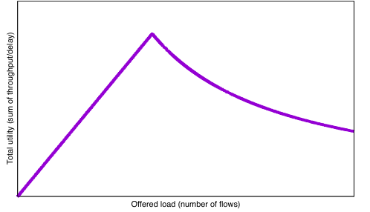
Congestion Collapse Example
* But when n increases s.t. n > C*RTT/w, then
(i) the throughput across each flow is C/n,
(ii) the latency increases due to queue build-up
* It can be shown that the aggregate utility is C²/nw
n* (w/RTT²)
C²/nw

Slide 35
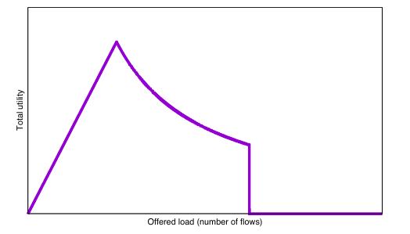
Congestion Collapse Example
Suppose you define utility which is more sensitive to latency; if latency > threshold, utility = 0
Typical behavior: if web-site is not loading, you just close it after a threshold time

Slide 36
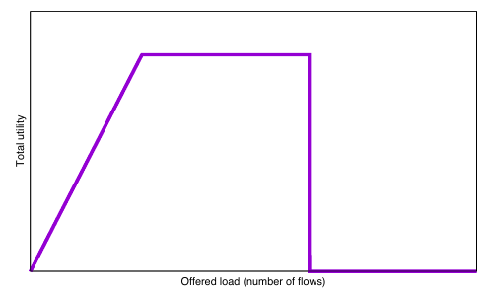
Congestion collapse due to retransmissions
* suppose that the retransmission logic is active, Then after a fixed timeout T > RTT, packet is retransmitted. Suppose utility only measures number of unique in order packets received at the receiver.
* Three regimes:
* nW < CRTT, utility (and throughput) increase linearly
* CRTT < nW < T, utility remains constant at C
* nW > T, retransmissions start, soon overwhelm the network, utility falls to 0
CRTT < nW < T
w < CRTT/n
nW > T

Slide 37
Congestion Collapse
* Congestion collapse was first observed in the 1980s due to retransmission.
* In 2009, congestion collapse was due to router buffers becoming very large, packets are seldom dropped thereby increasing the latency very much.
* Summary: although the network is heavily utilized, not all of it is contributing to useful throughput for the transport layer because the receiver is receiving duplicate packets.

Slide 38
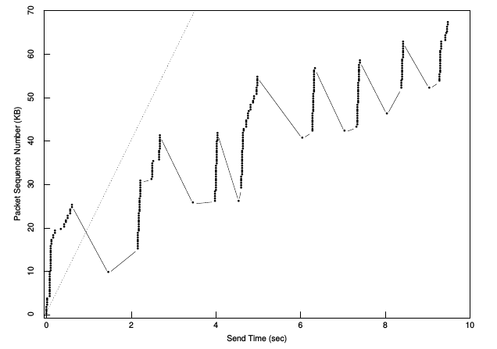
Startup Behavior of TCP: only 35% of the bandwidth is used for unique packet delivery; rest is wasted on retransmission of packets

Slide 39
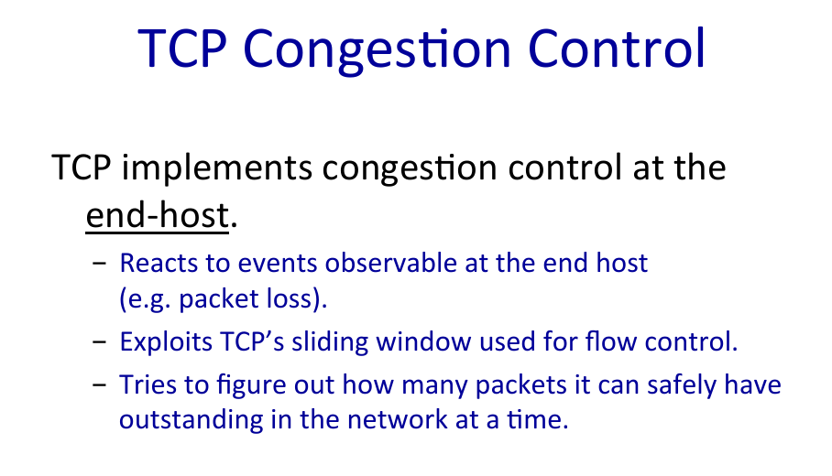
Congestion control algorithm is called AIMD
(Additive Increase Multiplicative Decrease)

Slide 40
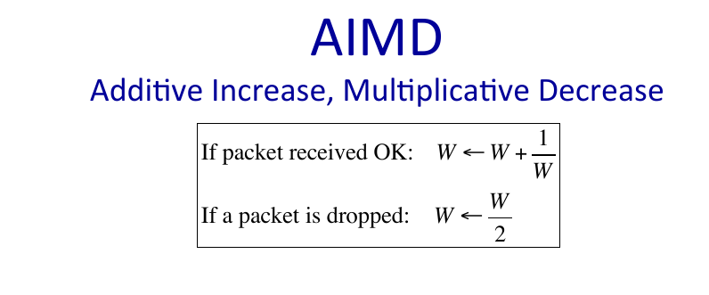

Slide 41
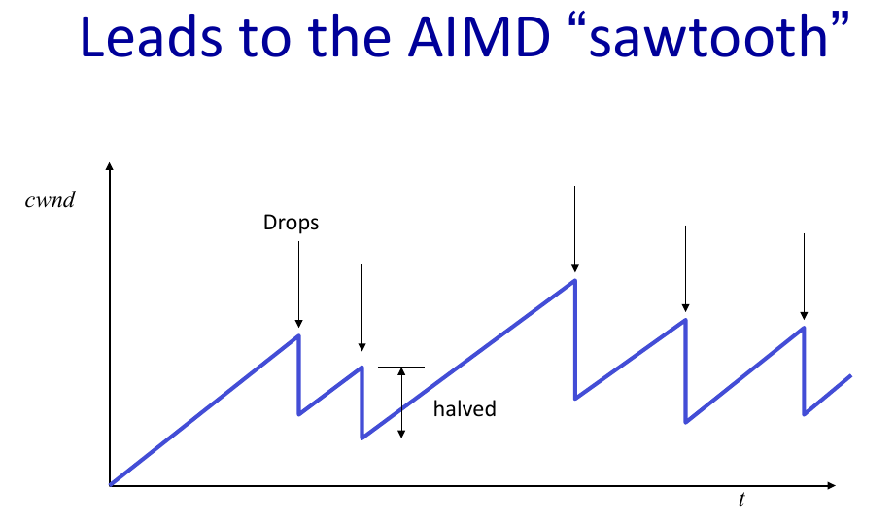

Slide 42
Notes:
– Think of the network as a bag, we are using AIMD to figure out what is the capacity of the bag?
– whenever the network links is full and you add an extra packet, the only place where the extra packet can go is the buffer.
– outgoing link is kept busy all the time

Slide 43
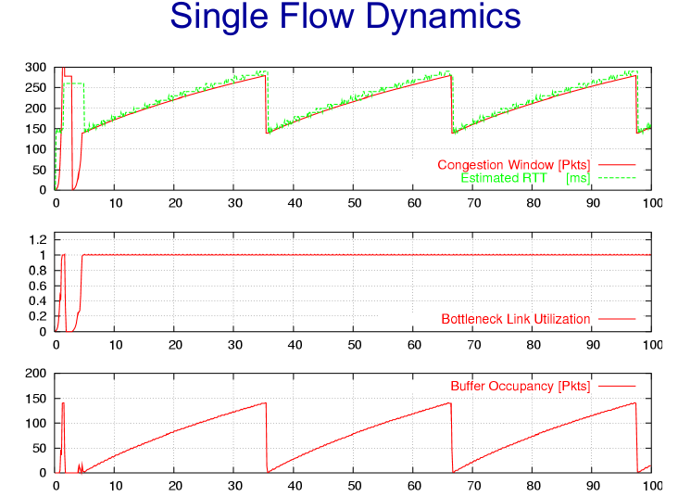
Notes:
Since w and RTT are varying, w/RTT is a constant.
We are not modulating the rate, we want to just keep the outgoing link busy.
Just constantly probing to find out what is the size of the bag in case the capacity has changed.
Buffer size = RTT x C

Slide 44
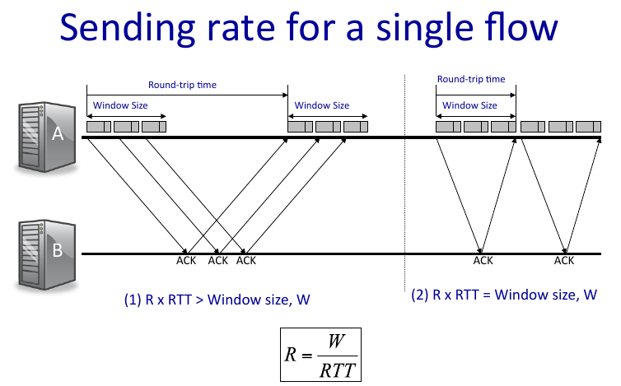

Slide 45
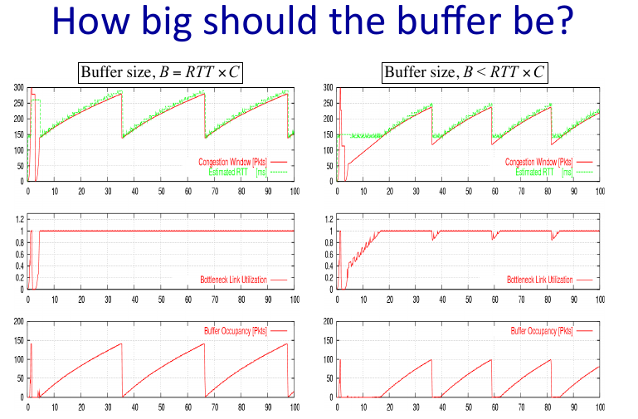

Slide 46
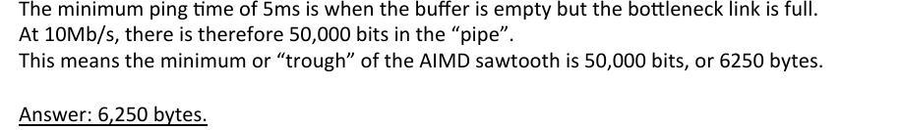
Alice is streaming a high definition video at 10Mb/s from a remote server in San Francisco. All packets are 250bytes long. She measures the ping time to the server and the minimum time she measures is 5ms. Once the AIMD window reaches steady state, the sawtooth oscillates between constant minimum and maximum values. The buffer is perfectly sized so that it is just big enough to never go empty.
1. What is the smallest value of the AIMD window (in bytes)?

Slide 47
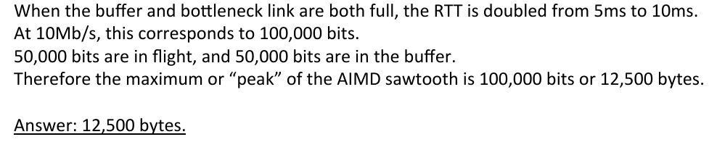
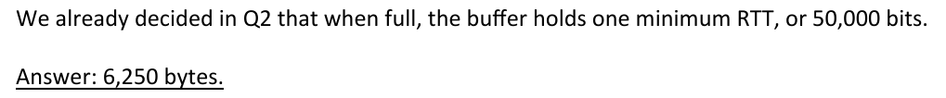
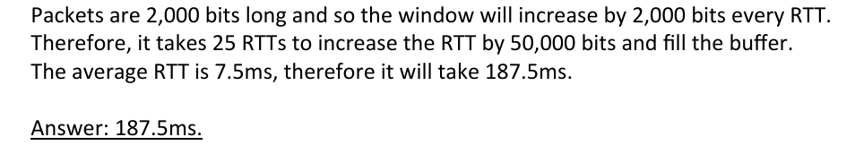
Largest value of the AIMD window
How big is the packet buffer in router?
After a packet is dropped, how long does it take for the window to reach the maximum value length?

Slide 48
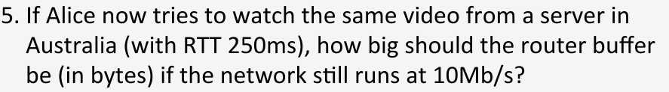
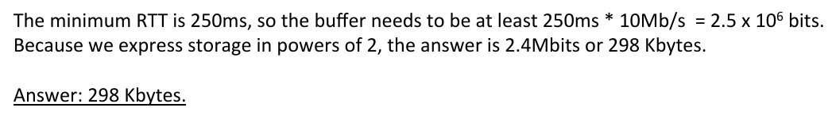
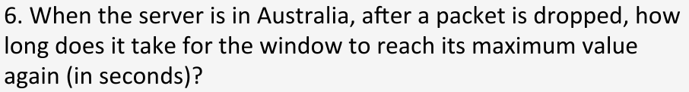
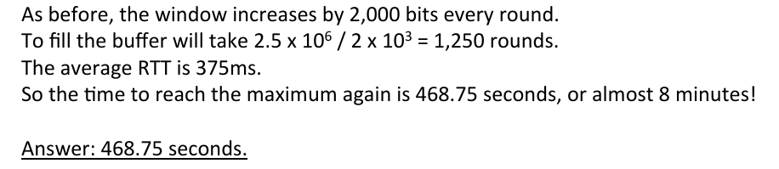

Slide 49
TCP Congestion Control
1. Slow Start: allows a sliding window sender to discover the right value of the window size starting from an extremely conservative initial window.
2. Congestion Avoidance: allows a sliding window sender that has reached the right window size to remain close to the right value as other senders arrive and depart from the network.

Slide 50
TCP Congestion Control
Slow Start
  The additive increase mechanism is the right approach to use when the source is operating close to the available capacity of the network, but it takes too long to ramp up a connection when it is starting from scratch.
  TCP therefore provides a second mechanism, ironically called slow start, that is used to increase the congestion window rapidly from a cold start.
  Slow start effectively increases the congestion window exponentially, rather than linearly.

Slide 51
TCP Congestion Control
Slow Start
  Specifically, the source starts out by setting CongestionWindow to one packet.
  When the ACK for this packet arrives, TCP adds 1 to CongestionWindow and then sends two packets.
  Upon receiving the corresponding two ACKs, TCP increments CongestionWindow by 2—one for each ACK—and next sends four packets.
  The end result is that TCP effectively doubles the number of packets it has in transit every RTT.

Slide 52
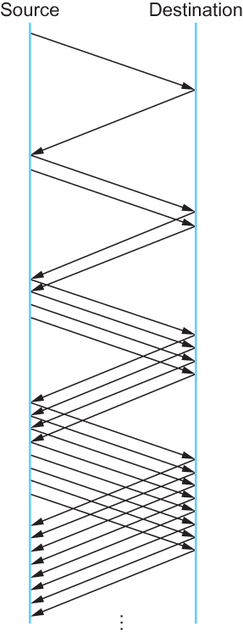
TCP Congestion Control
Slow Start
Packets in transit during slow start.

Slide 53
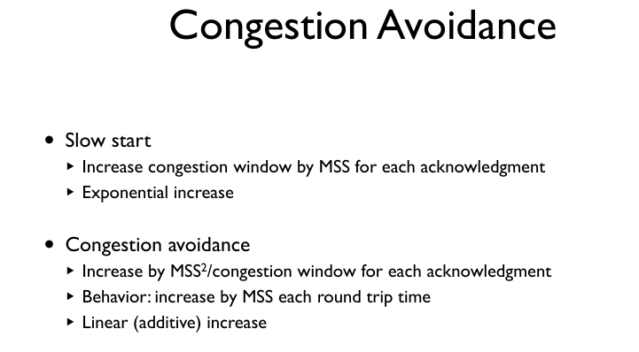

Slide 54
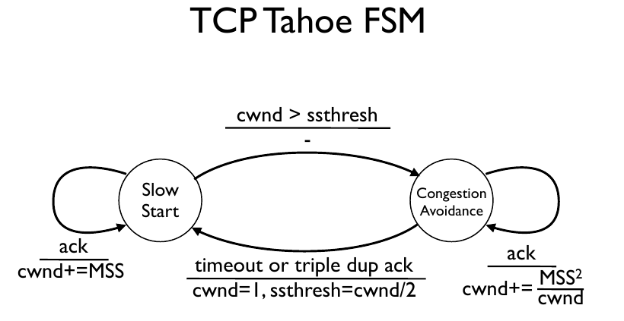

Slide 55
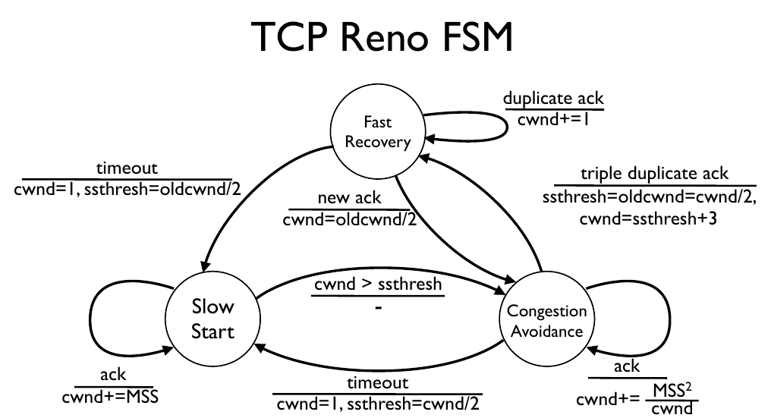

Slide 56
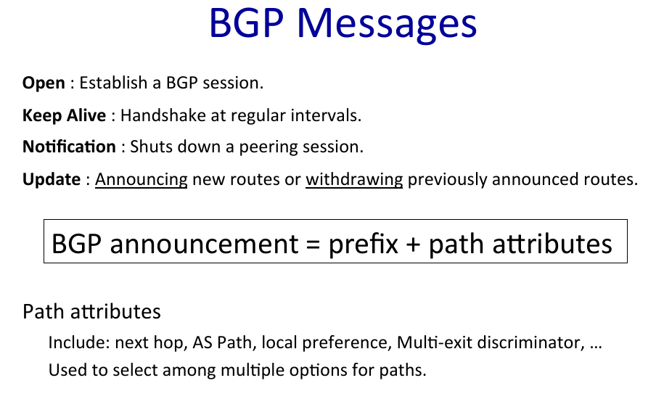

Slide 57
Congestion Control Today
The major differences between different congestion controllers lies in:
* what congestion signal they use
** Packet loss,
** Delay,
** Loss and delay
* who generates this congestion signal
(router, receiver, or sender), and what the senders do in response to these congestion signals.

Slide 58
References
[1] Congestion Control in IP/TCP Internetworks. https://tools.ietf.org/html/rfc896, 1984
[2] V. Jacobson. Congestion Avoidance and Control. SIGCOMM, 1988

